Slide 1
PN Junction Diodes

Slide 2
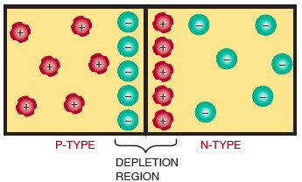
PN Junctions
Figure 20-1. Diode formed by joining P- and N-type material to form a PN junction.

Slide 3
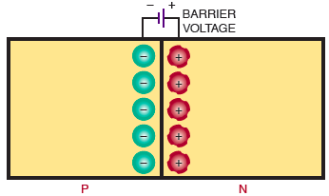
PN Junctions (cont’d.)
Figure 20-2. Barrier voltage as it exists across a PN junction.

Slide 4
After formation of junction
P and n types are not electrically neutral

Slide 5
Depletion Region
Builds up a voltage
Barrier voltage

Slide 6
Barrier Voltage becomes apparent when biasing is applied.

Slide 7
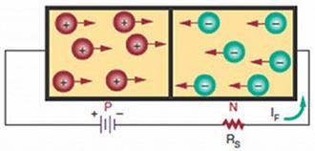
Diode Biasing
Figure 20-3. PN junction diode with forward bias.

Slide 8
External resistance in series to limit the current flow through the diode
FORWARD VOLTAGE DROP(EF)

Slide 9
QUESTION:
A silicon diode has an external bias voltage of 12V with an external resistance of 150Ω. What is the total forward current.

Slide 10
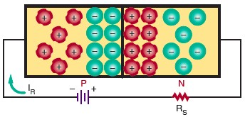
Diode Biasing (cont’d.)
Figure 20-4. PN junction diode with reverse bias.

Slide 11
The R.B. voltage increases the barrier voltage
Reverse Current--A small leakage current flows with the R.B.
At room temp., minority carriers few in numbers so small reverse current.
As temperature increases the number of majority carriers and leakage current increases.

Slide 12
Leakage Current Values
Diodes allow current to flow only in one direction-this makes them useful for RECTIFIERS

Slide 13

Diode Characteristics
Figure 20-5. Diode schematic symbol.

Slide 14
Diodes can be damaged by excessive heat and excessive reverse voltage.
Therefore,
Maximum Forward Current
Peak Inverse Voltage (PIV)
PIV exceeded , large IR flows, creating excessive heat and damaging the diode.
Also as temp. increases IR increases.

Slide 15
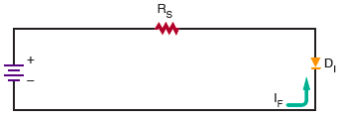
Diode Characteristics (cont’d.)
Figure 20-6. Diode connected with forward bias.

Slide 16
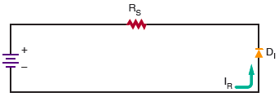
Diode Characteristics (cont’d.)
Figure 20-7. Diode connected with reverse bias.

Slide 17
Diode Construction Techniques
Types of PN junctions
Grown junction
Alloyed junction
Diffused junction

Slide 18
Testing PN Junction Diodes
Ohmmeter
Checks the forward-to-reverse-resistance ratio of a diode
Forward-biased diode
Low resistance
Reverse-biased diode
High resistance
DIODE SHORTED
DIODE OPENED

